Slide 1
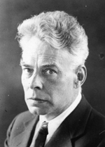

Absolute Structure
J.M.Bijvoet (1892-1980)
H.D.Flack (1943-2017)
Ton Spek
Bijvoet Center, Utrecht University (NL)
ECS4-School, Warsaw, 2-7 July, 2017

Slide 2
Absolute Structure
The term ‘absolute structure’ is a generalisation of the term ‘absolute configuration’ of objects such as molecules or crystals without an inversion centre or mirror plane. The concept also includes ‘absolute polarity’ of an object or crystal.

Slide 3
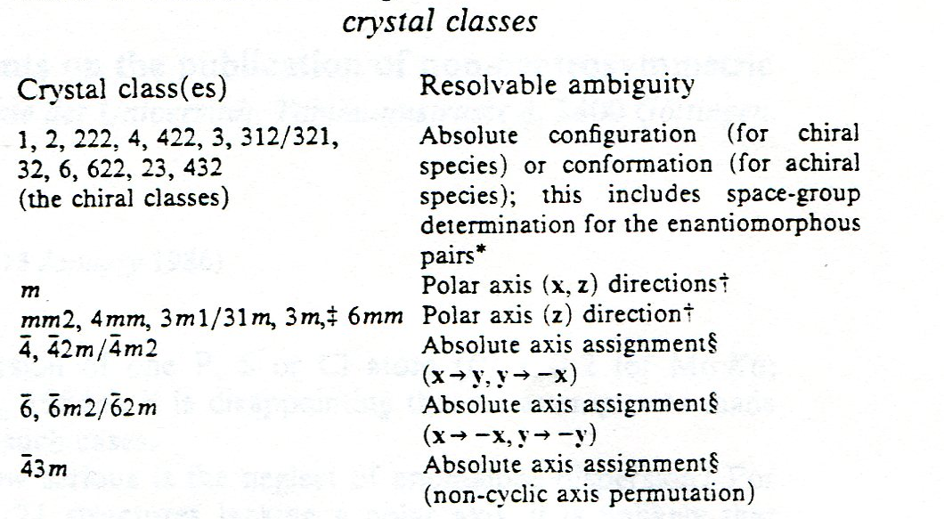
What is determined on Inversion

Slide 4
Absolute Configuration of molecules
Knowledge of the enantiomeric purity and chirality of drugs and their metabolites is important for the pharmaceutical industry.
An example is the Softenon disaster in 1960 with the drug Thalidomide where one of the enantiomers had a devastating effect with pregnant females.

Slide 5
Thalidomide (racemic)
Softenon Disaster
‘Good’
‘Bad’
Sedative
Pregnant
woman
Birth Defects

Slide 6
Howards Demonstration of the relation between inversion an mirror
Bear with
Left eye
blinded
Bear with right eye blinded

Slide 7
Absolute Configuration of Crystals
Crystals (and crystal structures) can have different absolute configurations
On inversion, the space group may remain the same (e.g. P2₁2₁2₁) or change (e.g. P3₁ into P3₂)
For 7 space groups, such as Fdd2, the space group (i.e. the symmetry operations) remains the same on inversion but an origin shift needs to be applied.

Slide 8
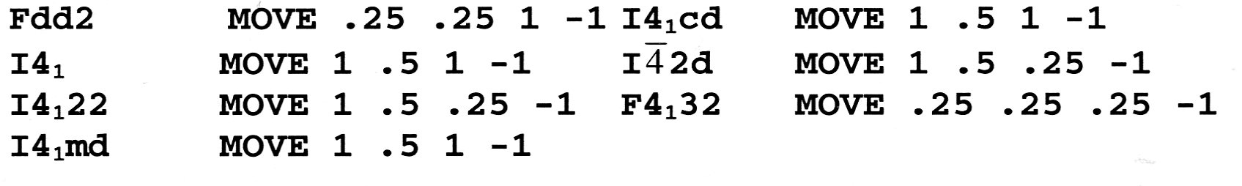
Space Groups Requiring a Move Instruction on Inversion
Associated SHELXL instructions

Slide 9
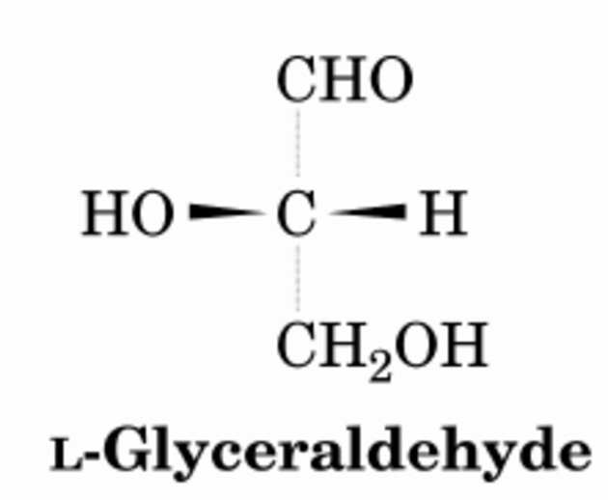
Fischer Convention
Emil Fischer arbitrarily assigned the absolute configuration to L-glyceraldehyde as shown below
All other absolute
configurations were
derived relative to
this one.
e.g. Tartaric acid

Slide 10
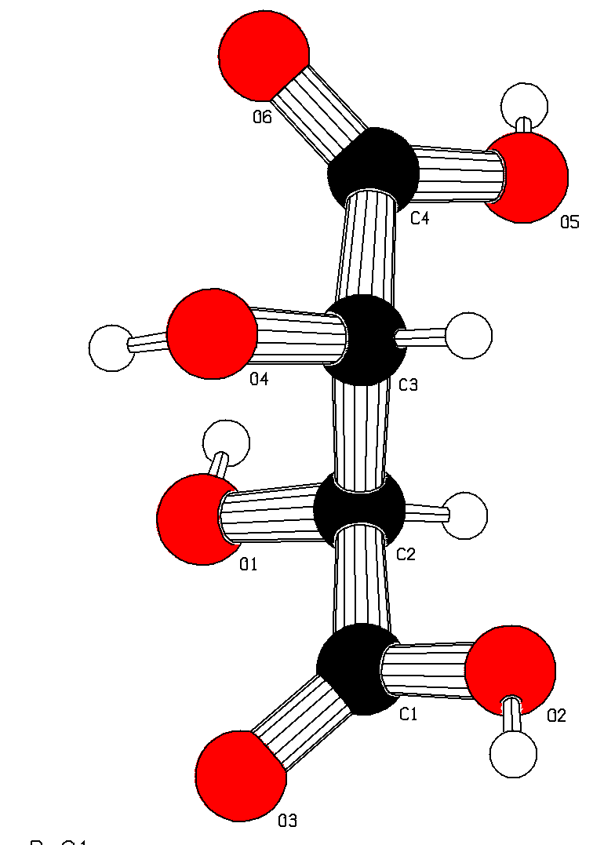
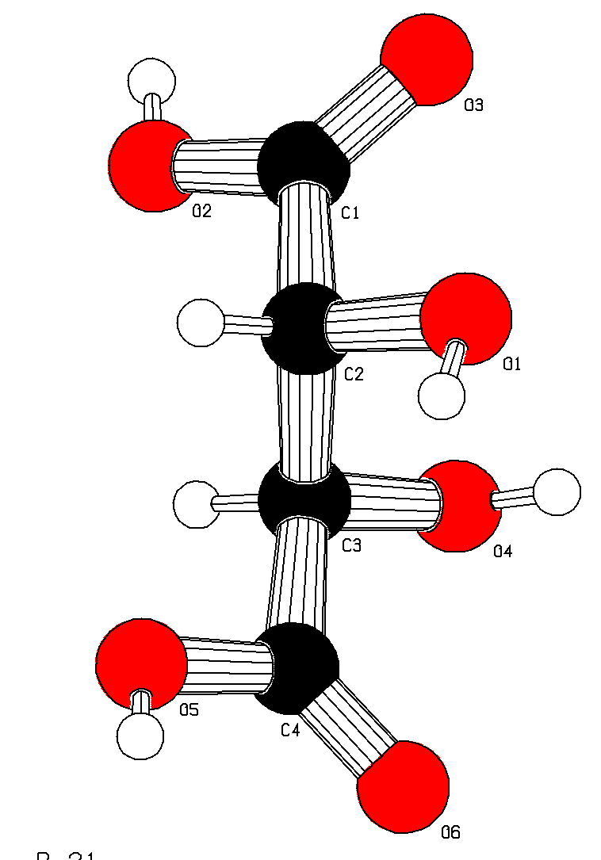
Fischer Absolute Configuration
(-) Tartaric acid (+) Tartaric acid

Slide 11
How to determine the absolute configuration of a given compound?
Before 1951 via a degradation pathway
It would be nice to have a direct test

Slide 12
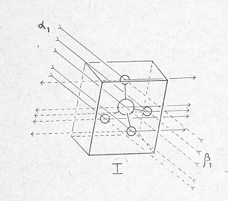
Can we use X-rays to determine absolute structure ?
H,K,L
Friedel
I_{hkl} = I_{-h-k-l}
Bijvoet
(non-centro-symmetric)
I_{hkl} ≠ I_{-h-k-l}
-H,-K,-L
Friedel Pair of Reflections

Slide 13
Complex Scattering Factors
Atomic Scattering Factor: f = f₀ + f’(λ) + if”(λ)
f’(λ) & f”(λ) components: designated as Resonant scattering, anomalous dispersion or anomalous scattering
Can be used for absolute structure determination
F₀ decays with theta, not so much f’(λ) and f”(λ) [because related to the inner core electrons]

Slide 14
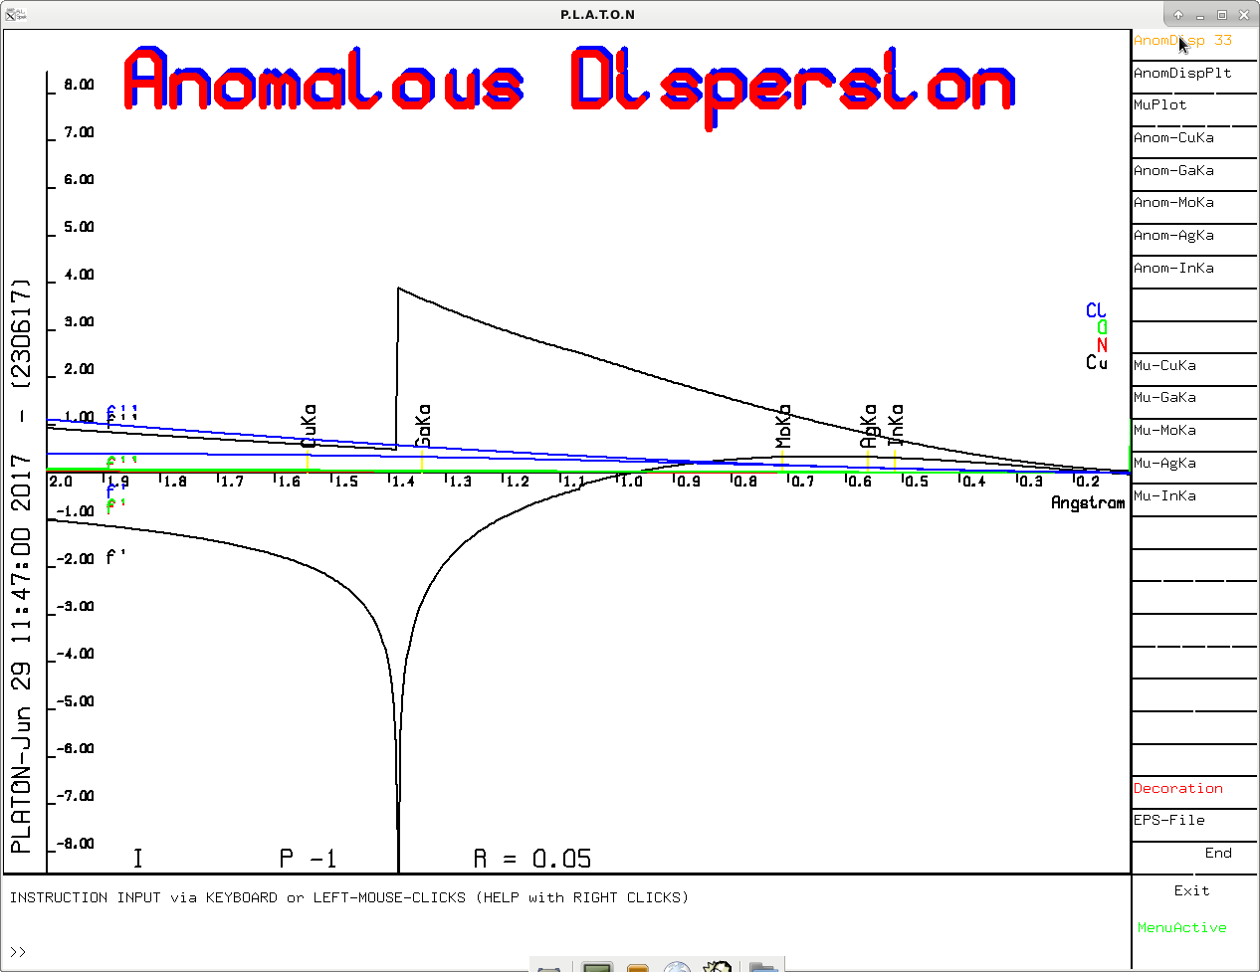
Function of λ and element type
Cl, O, N, Cu Compound
f”(Cu)
f’ (Cu)

Slide 15
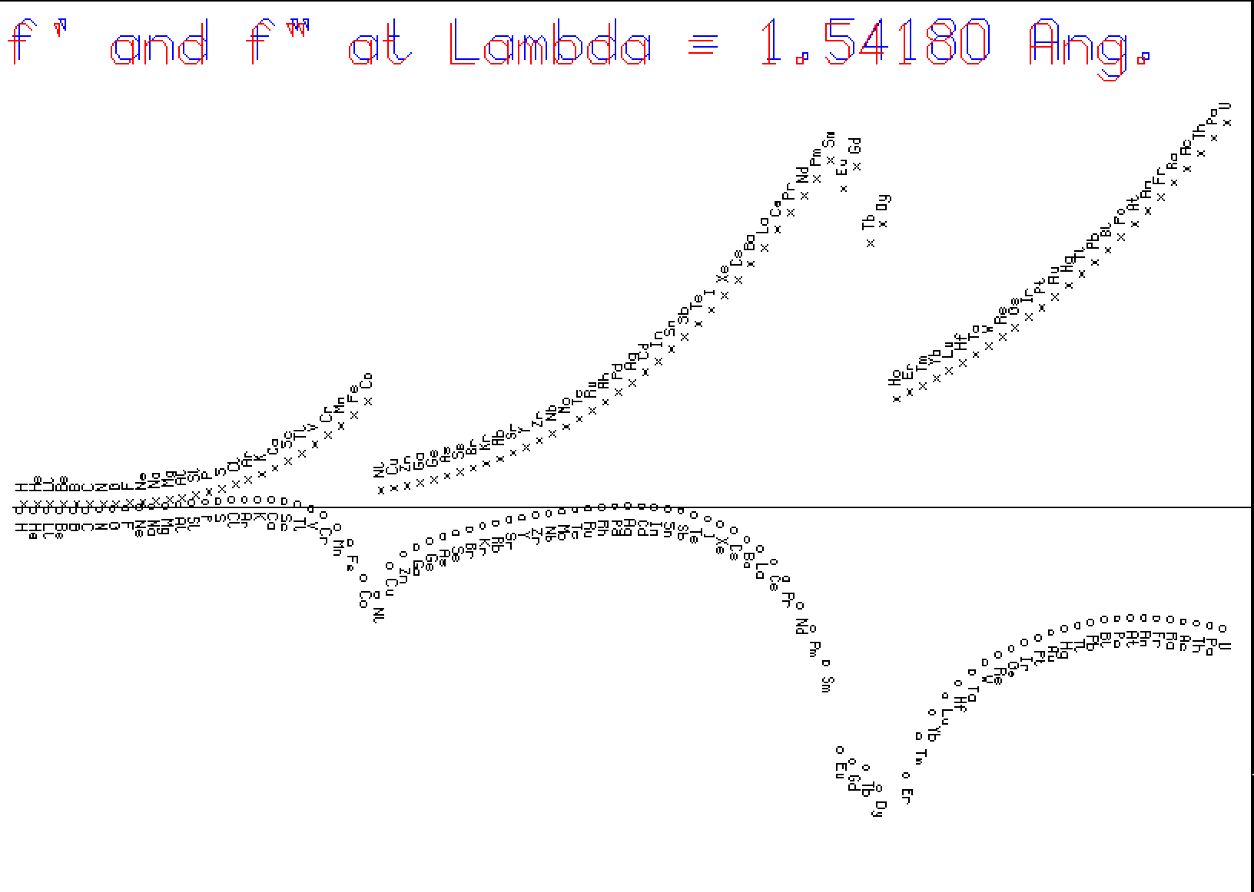
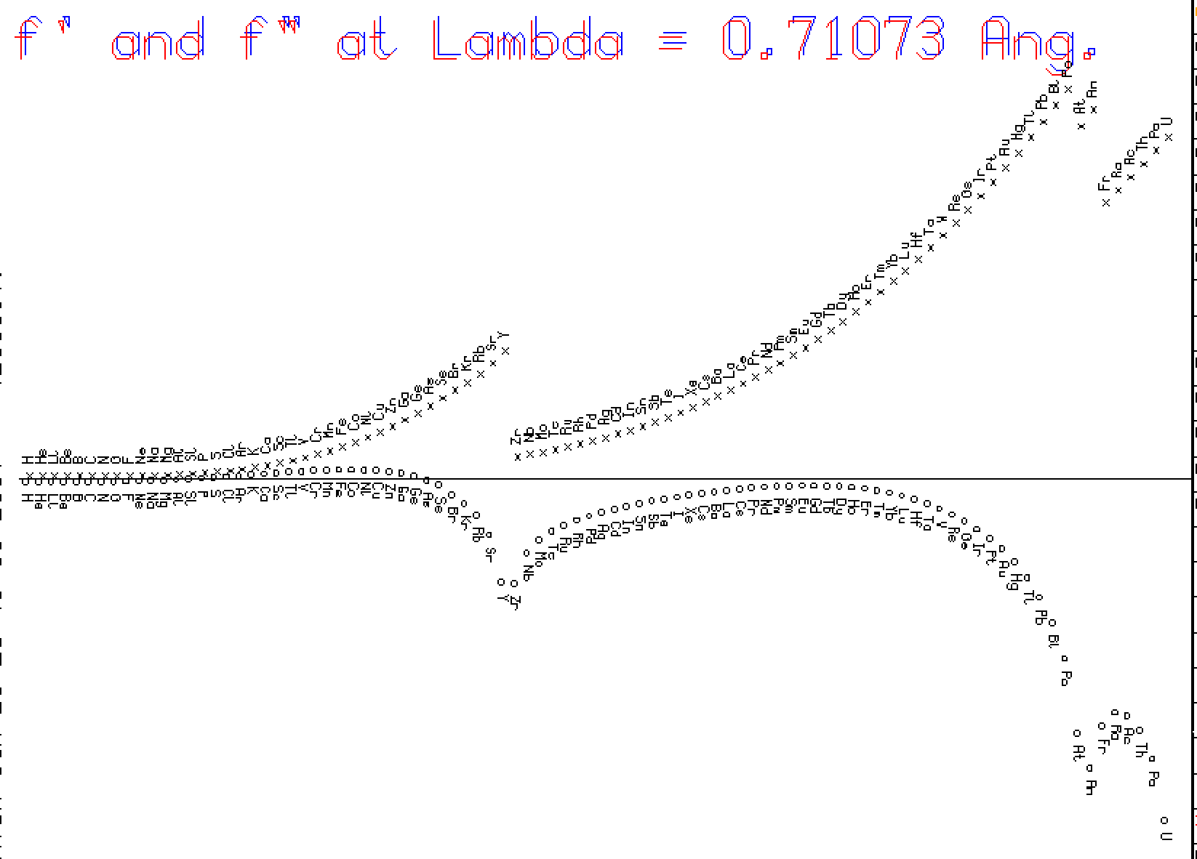
Z
Z

Slide 16
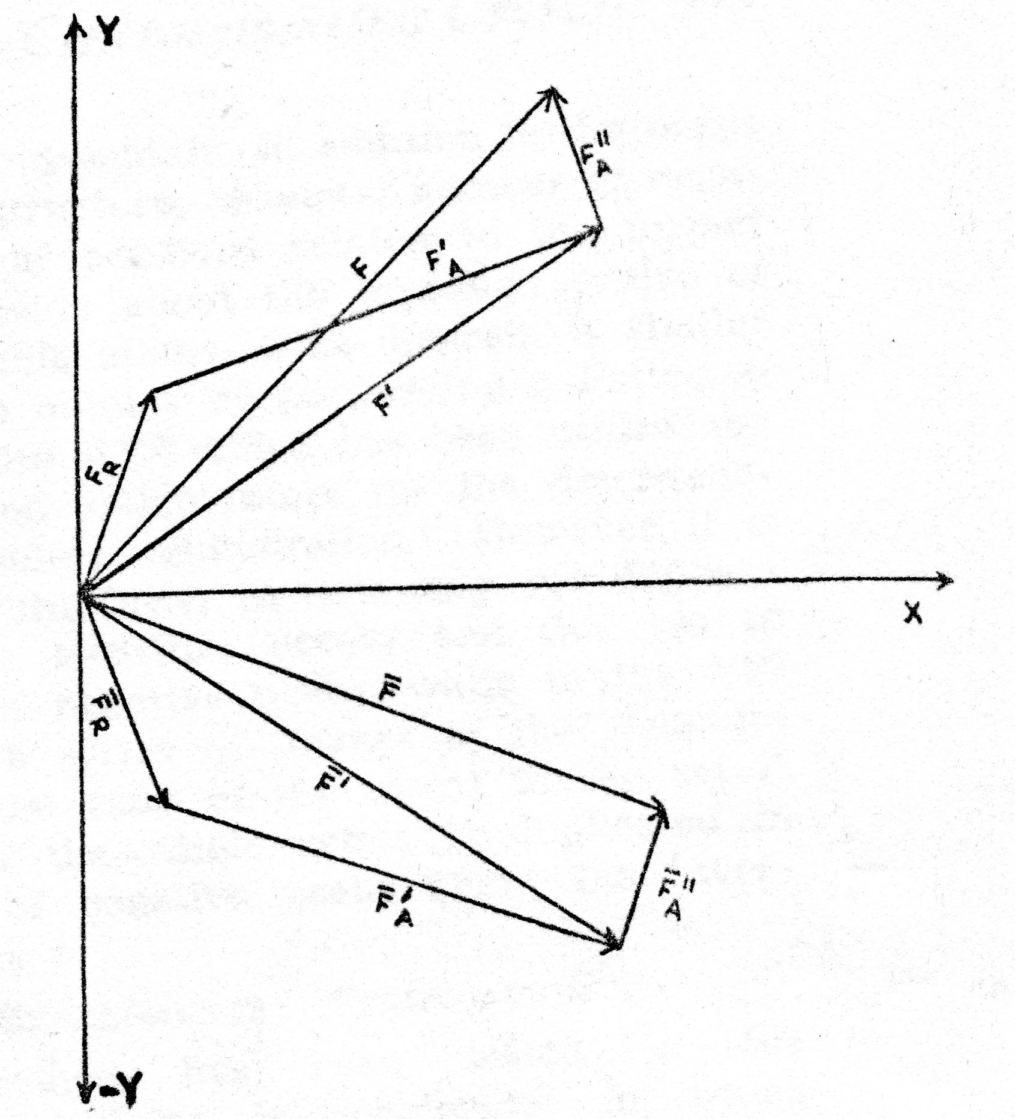
F_{hkl}
Effect of f”
Construction in the Complex Plane
F_{hkl}(real)
|F_{hkl}| > |F_{-h-k-l}|
F_{-h-k-l}
|F_{hkl}(real)=F_{-h-k-l}(real)
F_{-h-h-l}(real)

Slide 17
The First Absolute Structures
The first absolute structure determination with X-rays was done on ZnS by Nishikawa & Matukawa, (1928), Coster, Knol & Prins (1930). They could correlate the macroscopic shiny and dull (111) faces with microscopic S and Zn layers respectively.
Bijvoet suggested in 1949 the generalization of the 1D polarity determination to 3D chirality determination of organic molecules (as opposed to relative to the arbitrary assigned L configuration of (+) tartaric acid: the Emil Fischer convention).
Na Rb Tartrate (Bijvoet et al., 1951, Nature)

Slide 18
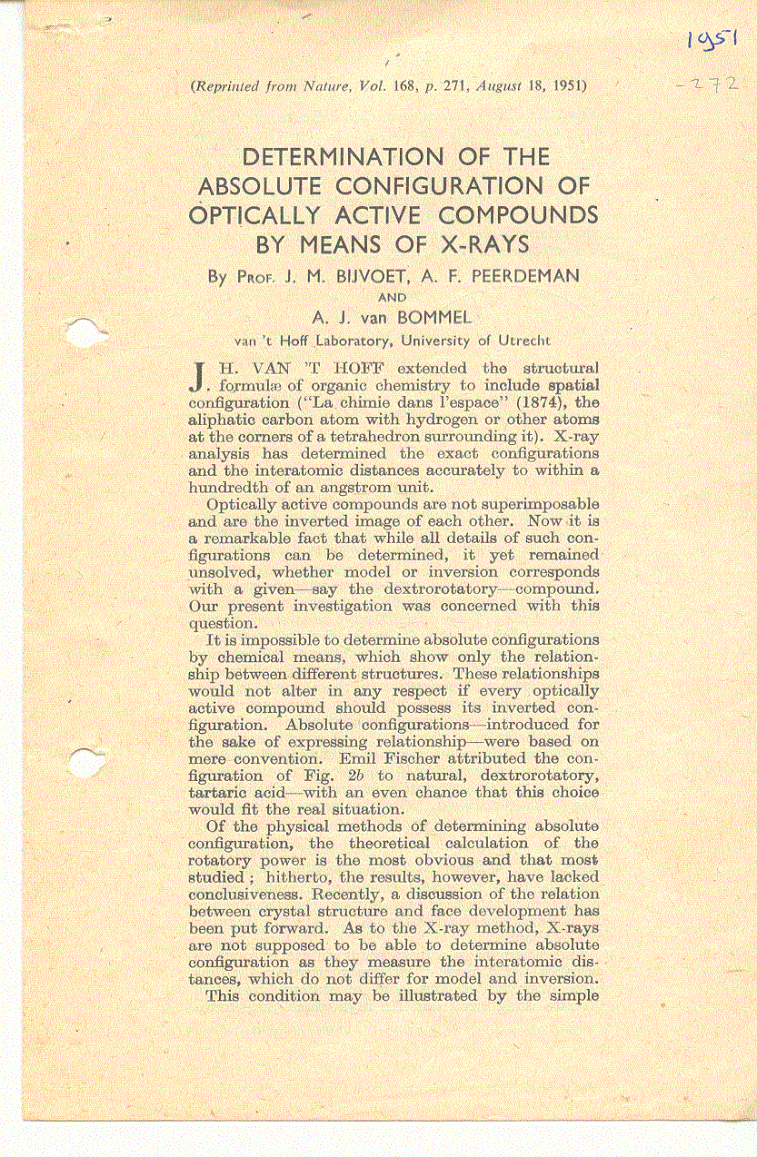
The First page
of the famous
1951 Article
in Nature
-
Emil Fischer
with his arbitrary
convention of
absolute structure
turned out to
have made by chance
the correct choice
-
Notes:
18

Slide 19
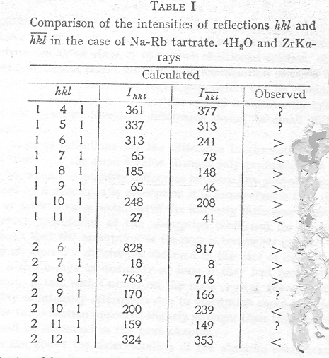
Qualitative
Long Exposures
Unstable
X-Ray Sources
Notes:
19

Slide 20
Experiments of Bijvoet et al.
‘Accurate measurement of the Intensities of Friedel Pairs’
On Mixed salts of (+) Tartaric Acids
NaRb Tartrate
NaH Tartrate
Using X-ray Film techniques (ZrK radiation)
Long exposure times with unstable source

Slide 21
BIJVOET: Absolute Configuration
Voor 1951 (-)-Tartaric acid (+)-Tartaric acic Fischer (Arbitrary)
Na 1951: (S,S)-(-)-Tartaric acid (R,R)-(+)-Tartaric acid Bijvoet (Experiment)

Slide 22
Absolute Structure Determinations in the Point Detector era
Assume enantiopure compounds
Correlate macroscopic properties (dextro or levo rotary power) with the associated microscopic absolute configuration.
Solve the structure and make a list of Bijvoet pairs with significantly differing calculated intensities.
Remeasure the intensities with great care.

Slide 23
Issues with this Approach
The Bijvoet differences need to be significant as compared to its s.u.
Generally a strong resonant scatterer should be present in the structure (not always the case with natural compounds of interest)
Sometimes, the compound of interest may be crystallized as a salt (e.g. with HBr)
Absorption effects may have to be considered

Slide 24
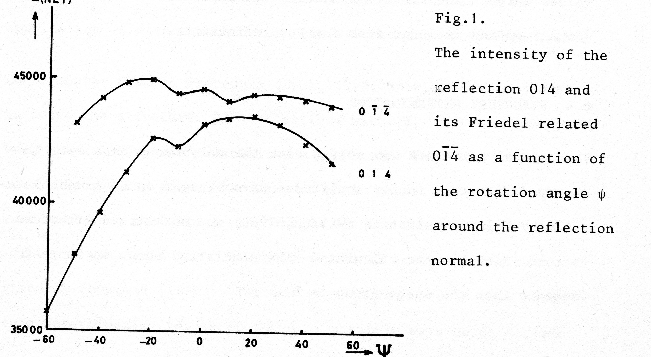
Inspect Bijvoet Difference as a Function of Ψ

Slide 25
A Better Approach
Collect not just an asymmetric set of reflections of the Laue group but also a Bijvoet pair related set of reflections (costly in those days because data collection time was linearly related to the number of reflections)
Refine both the structure model and an inverted model with those data and keep the model with the lowest R-value

Slide 26
Selection of Bijvoet related Asymmetric Units
Example: Space group P2₁2₁2₁
Two sets octants of symmetry related reflections
SET1: HKL, -H-KL, H-K-L, -HK-L
SET2: -H-K-L, HK-L, -HKL, H-KL
Any octant of SET1 with any octant of SET2 will do

Slide 27
The η Parameter Refinement Approach
Rogers introduced the refineable η parameter in the expression of the scattering factor:
f = f₀ + f’ + iηf’’
Where η is expected to refine to either 1 or -1
The associated s.u. could associate some reliability to the absolute structure assignment.
The method was criticised of having no physical basis, in particular when η = 0

Slide 28
Flack Parameter
Howard Flack came up with the physically realistic inversion twin model. Flack, H.D. (1983). Acta Cryst. A39, 876-881.
I_{H}(calc) = (1 – x) |F_{H}(calc)|² + x |F_{-H}(calc)|²
where I_{H}(calc) is refined with the additional parameter x in the least squared refinement against I_{H}(obs).
The result is a value for x with associated s.u. value
x has physically a value in the 0 and 1 range

Slide 29
Interpretation of the Flack x
H.D.Flack & G. Bernardinelli (2000)
J. Appl. Cryst. 33, 1143-1148.
For a statistically valid determination of the absolute structure:
s.u. should be < 0.04 and |x| < 2s.u
For a compound with known enantiopurity:
s.u. should be < 0.1 and |x| < 2s.u

Slide 30
The Friedif Parameter
Flack & Shmueli (2007) introduced a parameter, named Friedif, as a measure for the magnitude of the resonant scattering effect of a given compound. Its value can be calculated on the basis of the unit cell content and measurement wavelength.

Slide 31
Measure for Success
A correlation was found between the value of the Friedif parameter and the s.u. that can be reached on x.
A value of 80 or more is indicates for few absolute structure determination problems.
A value of 34 or lower indicates difficulties to reach an s.u. on the Flack parameter less than 0.1.

Slide 32
Consolidation
The Flack x twinning model consolidated the absolute structure determination issue for more than 20 years.
Crystals are not always enantiomerically pure. The Flack x also covers cases of various degrees of racemic mixtures.
Flack x implemented in all refinement packages (SHELXL, OLEX2, JANA,CRYSTALS ..)

Slide 33
SHELXL Flack x Implementations
(1) - As an additional refined parameter with the BASF/TWIN instructions
(2) – As a post refinement test (refining x only), also known as the hole-in-one.
Note: when x, as determined with (2), deviates significantly from 0.0, still option (1) has to be done to include the racemic mixture effect to the structure factors and refinement.

Slide 34
Potential problems with the ‘hole-in-one’ calculation of Flack x
Flack x refinement does not necessarily require a Bijvoet pair set of reflections in order to produce results.
This can lead to improper coupling of x with the model coordinates.
Under certain conditions, the Flack parameter value can stay at the input value, thus suggesting incorrectly enantiopurity.

Slide 35
Flack x and Light Atom Structures
Absolute structure determination is in particular relevant for pharmaceuticals and natural products.
The Flack & Bernardinelli criteria can rarely be met with those compounds (Friedif value low)
Experience with structures of known absolute structure in this category suggested an overestimation of the Flack x s.u.

Slide 36
New Approaches
Attention shifted back to the detailed analysis of the Bijvoet pair difference intensities.
Parsons & Flack (Acta Cryst. 2004, A60, s61) reported tests with the introduction of Bijvoet differences in the least squares refinement, a method that was fully described as the quotient method in Parsons et.al. (2013) B69,249-259 and its implementation in CRYSTALS [Cooper et al. (2016) C72, 261,267].

Slide 37
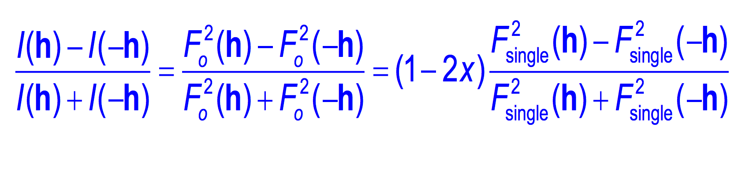
The Quotient Method
This expressing can be solved with
simple linear least squares:
y = mx, where m = (1 - 2x)
And finally, Flack x = (1 – m) /2

Slide 38
New Approaches
The Quotient method is now frequently implemented as a post-refinement estimate of the Flack parameter in e.g. SHELXL & PLATON
Another way to introduce Bijvoet differences, based on Bayesian statistics, was introduced by Hooft et al.(2008) : The Hooft y parameter, is also a post-refinement estimate of Flack x (PLATON & CheckCIF, CRYSTALS).

Slide 39

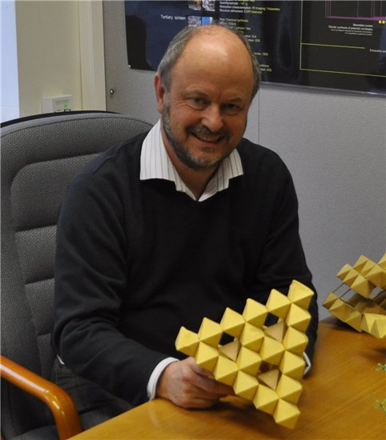
The Hooft Approach to Absolute Structure Assignment
The idea for the Hooft parameters originated from discussions with Prof. Bill David during the 2005 Crystallographic Computing School in Siena, Italy, who suggested the use of Bayesian Statistics.
Rob Hooft
Bill David

Slide 40
Papers with Details
Determination of absolute structure using Bayesian statistics on Bijvoet differences, , R.W.W.Hooft, L.H.Straver & A.L.Spek, J. Appl. Cryst. (2008),41, 96-103.
Probability plots based on Student’s t-distribution, R.W.W.Hooft, L.H.Straver & A.L.Spek. Acta Cryst. (2009), A65, 319-321.
Using the t-distribution to improve the absolute structure assignment with likelyhood calculations, , R.W.W.Hooft, L.H.Straver & A.L.Spek, J. Appl. Cryst. (2010), 43, 665-668.

Slide 41
Bijvoet pair Analysis in PLATON
1 – Implementation of the Quotient method as a post refinement determination of the Parsons z parameter approximation of Flack x
2 – A graphical analysis of observed versus calculated Bijvoet differences
3 – The Hooft y analysis assuming Gaussian error distribution (post refinement)
4 – The Hooft y analysis assuming student-t error distribution (post refinement)

Slide 42
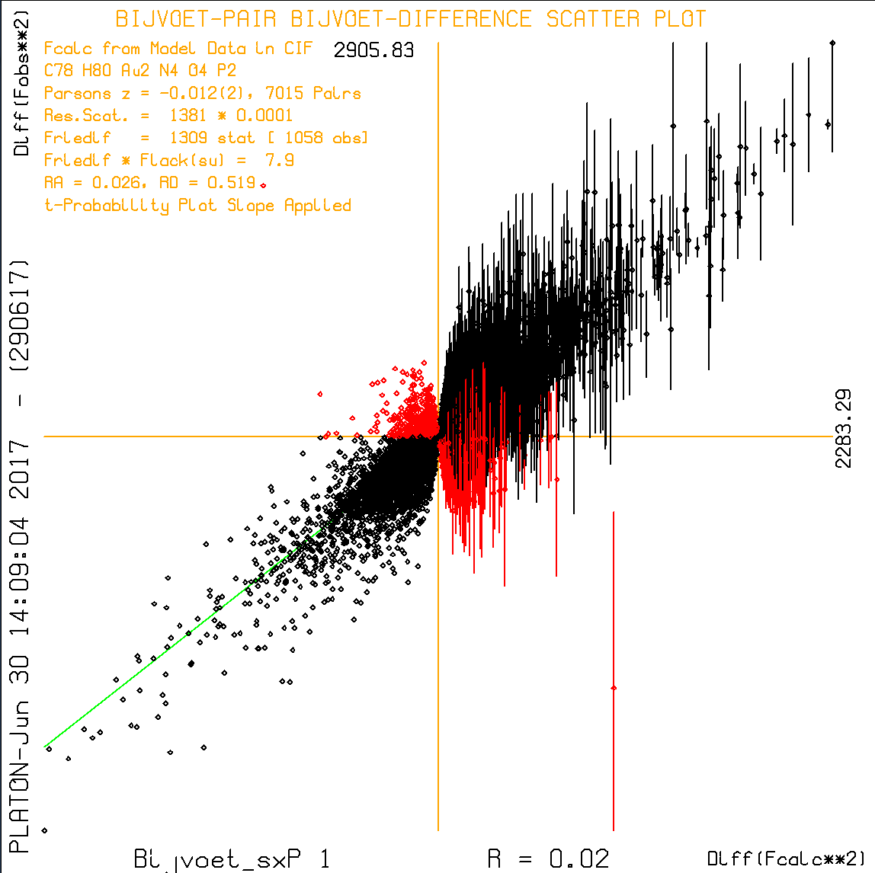
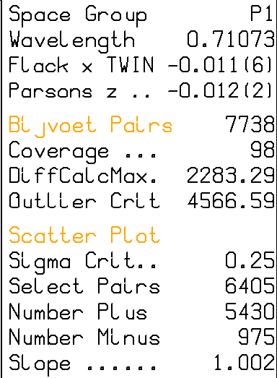
Scatter Plot of Bijvoet Pair Differeces

Slide 43
Outliers
Bijvoet difference methods are sensitive for strong outliers.
For that reason, all observed Bijvoet differences greater than two times the maximum calculated Bijvoet difference are eliminated.

Slide 44
The Hooft Parameter
The parameter value that is determined with the Hooft method is called G with a formal range between 1 & -1 and eventually converted into the Flack x equivalent Hooft y = (1 – G) / 2.
The assumption made is that the differences
(GΔF_{H}(calc)² – ΔF_{H}(obs)²)/σ(ΔF_{H}(obs)² ) are normally distributed. This can be tested with a normal probability plot.

Slide 45
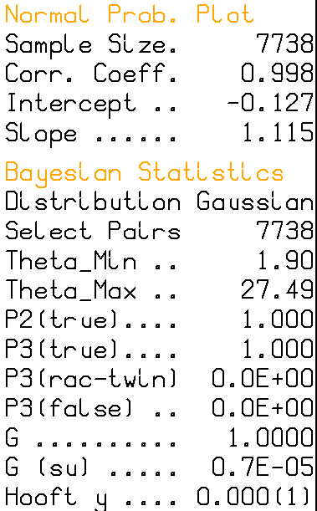
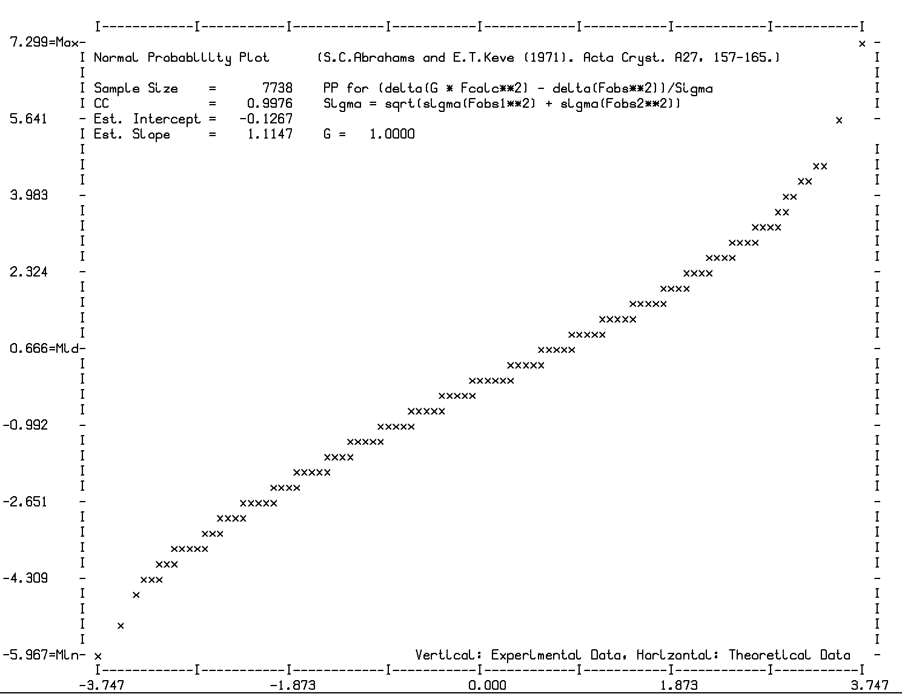
Hooft Analysis Assuming Gaussian Error Distribution of Bijvoet Pairs

Slide 46
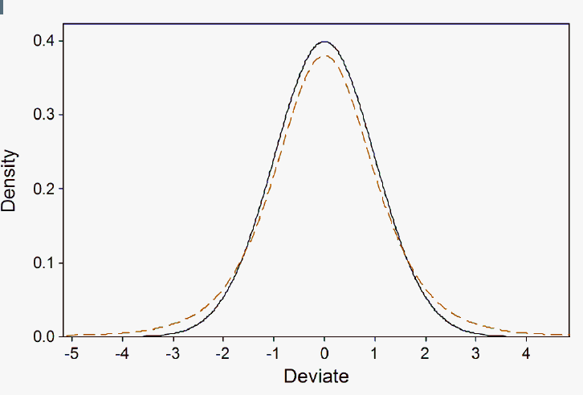
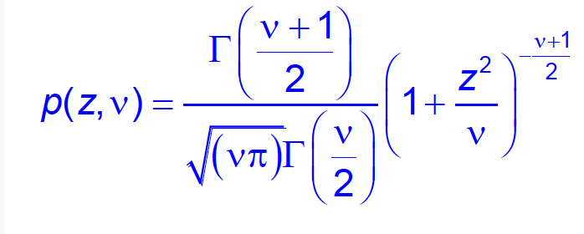
Testing the more general student–t distribution
p(z,ν) approximates Gaussian for large ν values
The student-t distribution should handle outliers more
automatically

Slide 47
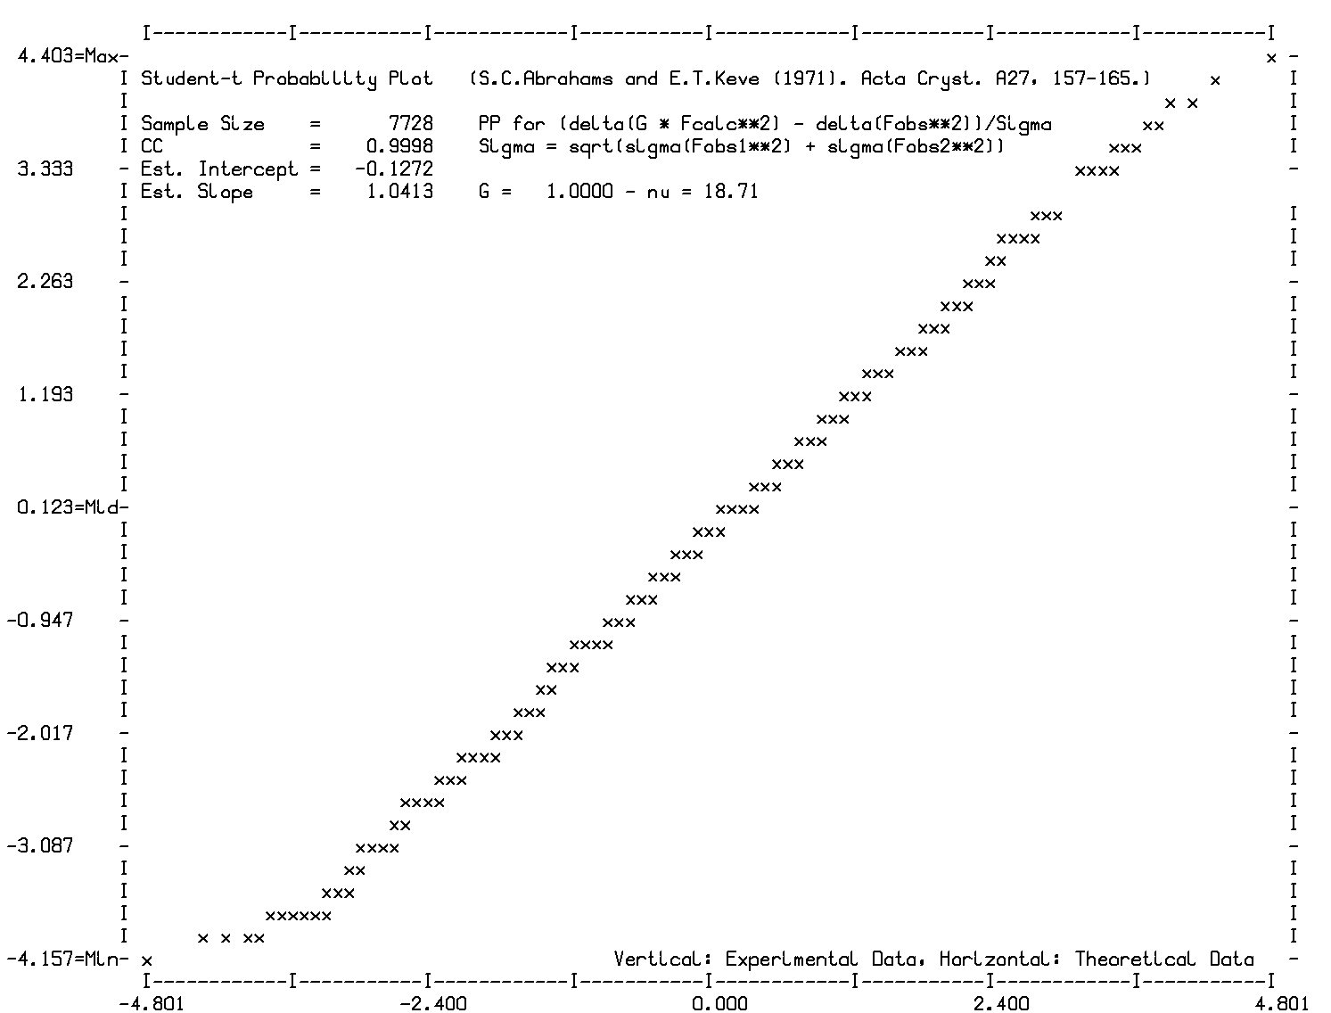
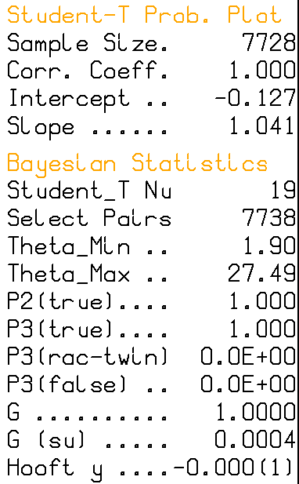
Hooft Analysis Assuming Student-t Error Distribution of Bijvoet Pairs

Slide 48
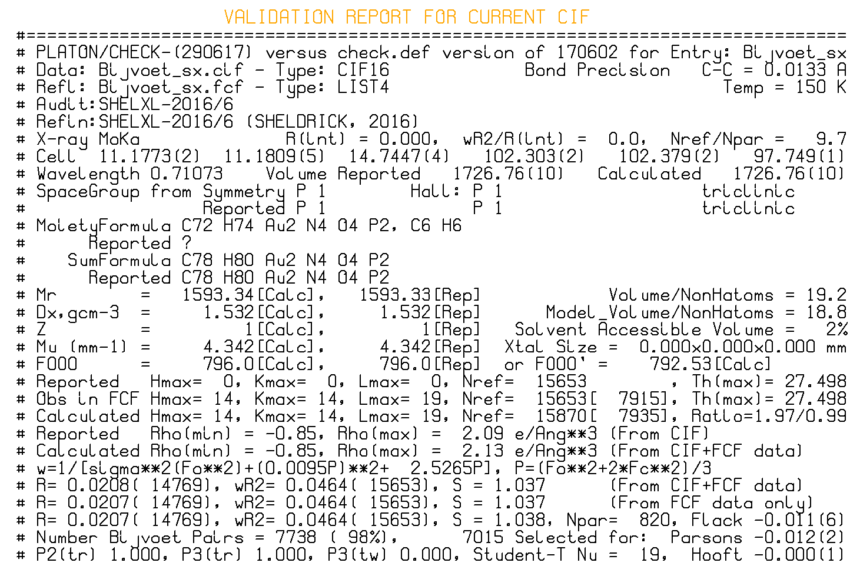
First page of Validation Report

Slide 49
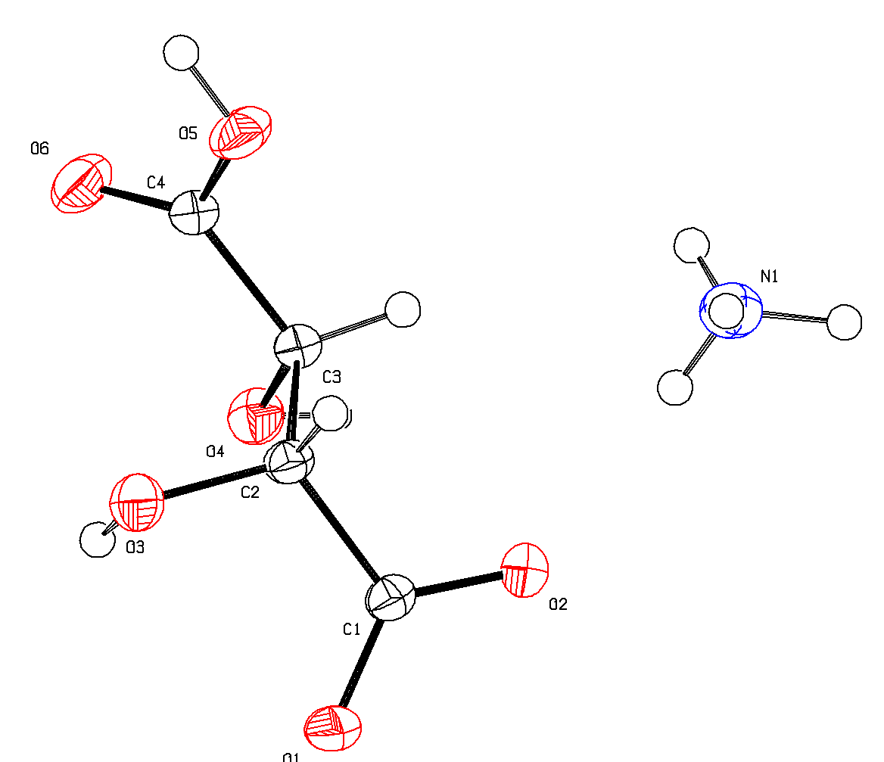
Extreme Example
P212121
MoKa, 0.71073
f”(O) = 0.006
f”(N) = 0.003
f”(C) = 0.002
f”(H) = 0.000
Ammonium Hydrogen D-Tartrate

Slide 50
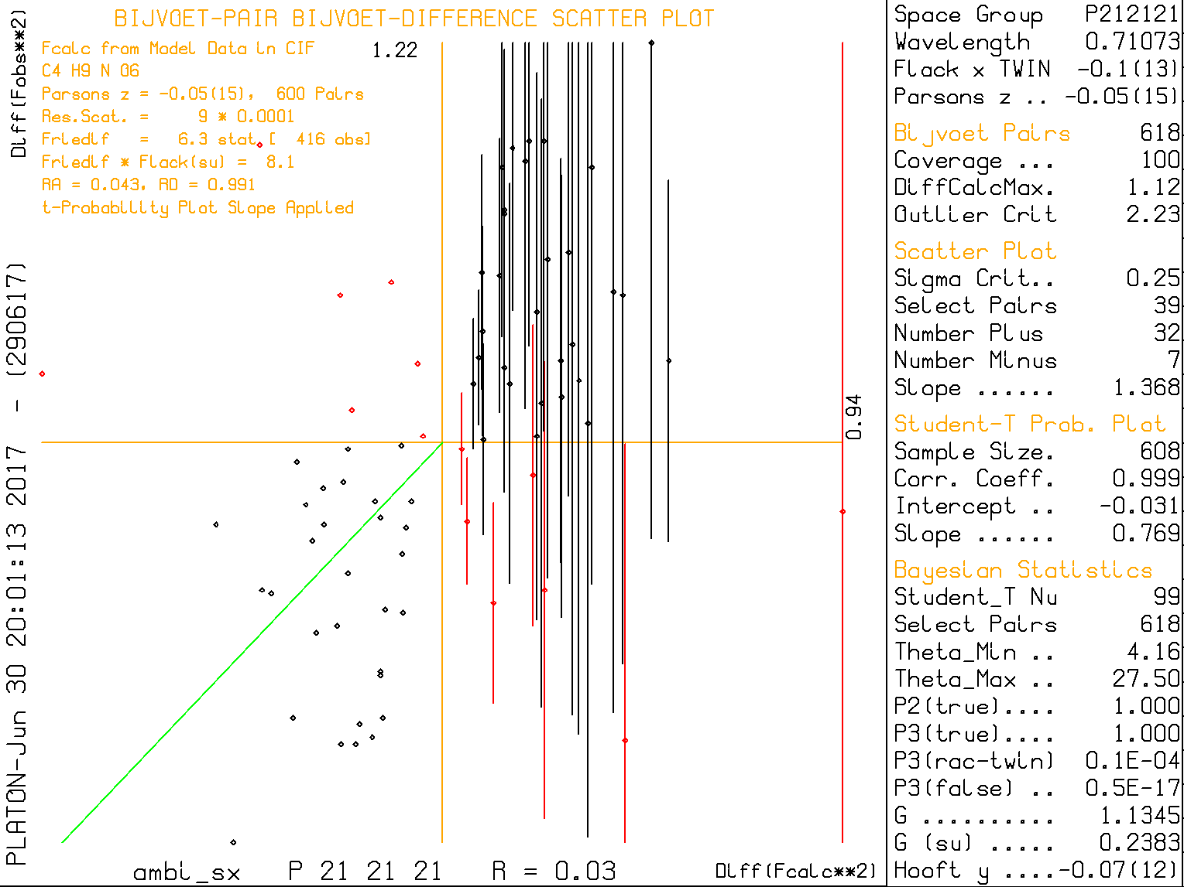

Slide 51
Various Estimates of the Inversion Twinning Parameter x
x: The classical least-squares Flack parameter
x’: The post-refinement classical Flack x
y: The post-refinement Hooft parameter
y,ν: The student-t based Hooft parameters
z: The post-refinement Parsons parameter
Min(x’,z): post-refinement Flack x in SHELXL
Confusion ? About what is reported in the CIF

Slide 52
Tests
- Parsons, Flack & Wagner, Acta Cryst. (2013), B69, 249-259 carried out tests with a large number of low friedif values structures with known absolute structure.
- The found the Quotient and Hooft methods largely consistent

Slide 53
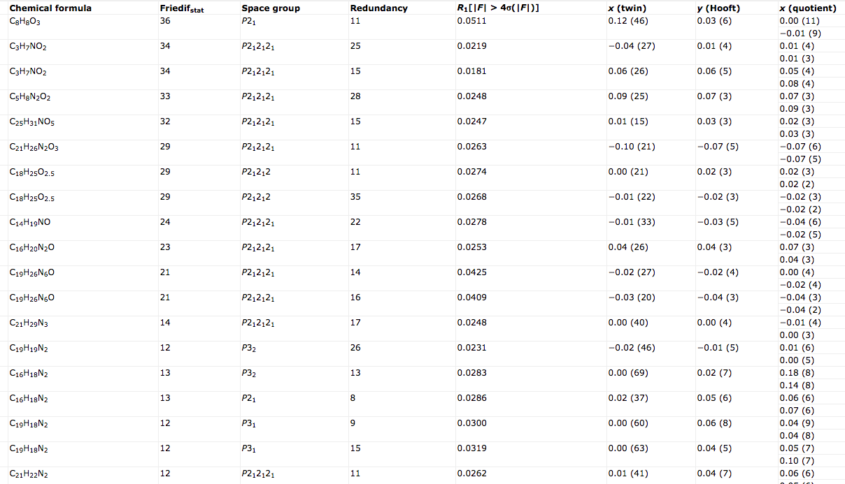
Tests by Parsons, Flack & Wagner, Acta Cryst. (2013), B69, 249-259

Slide 54
Concluding Remarks on ‘Flack x’
Use CuKa radiation for low Friedif structures
Collect high redundancy data
Collect complete set of Bijvoet pairs
Use the centrosymmetric Laue group for multiscan absorption correction (e.g. SADABS)
Try to idenfify and eliminate outliers
Rely on more than one ‘Flack x’ estimate.

Slide 55
Concluding Remarks
- Post-refinement Quotient and Hooft et al. methods give significantly more precise Flack x values than the classical method.
- Initially, there were reservations concerning not accounted for correlations of x with the other model parameters.
- Leverage Analysis learned that the above concerns do no longer exist.
- The post-refinement s.u.’s are thus more realistic.

Slide 56
For more Detailed Analyses
Watkin & Cooper (2016). Acta Cryst. B72, 661-683.
Cooper, Watkin & Flack (2016). Acta Cryst. C72, 261-267.
Copies of this talk at www.platonsoft.nl

Slide 57

Thanks!

