Slide 1
PLATON and raw diffraction data opportunities for chemical crystallography publishing
Ton Spek
Utrecht University
The Netherlands
Vienna –ECM32-18-08-2019

Slide 2
What is a Crystal Structure Report?
A published crystal structure represents its author’s interpretation of the underlying experimental diffraction data
Often the main stuctural result that is presented in chemical journals is just an ORTEP like illustration as ‘proof’ of the chemistry and a CSD reference code for crystallographic details.

Slide 3
The Problem is ..
The interpretation might be erroneous.
Qualifiers such as ‘best attainable’ and ‘sufficient for the purpose of the study’ are often lost in the archive or ignored by the users of the structural results.
(Unreported) constraints and restraints may make the sometimes elaborate discussion of the details of the molecular geometry largely meaningless.

Slide 4
What is needed for a good Report ?
Archival of the experimental data, details of the data reduction, details of the refinement.
The possibility to repeat the structure analysis in order to investigate claimed unusual results.
The option to use the experimental data for unrelated research that might require more advanced analysis of the data.
Note: the experimental data may be unique or not easily obtained again.

Slide 5
The Current Solution
The CIF standard introduced in the 1990’s gives the option to archive the relevant information electronically as opposed to the need to retype data from archived printed material. [Dick Marsh retyped the Fo/Fc data]
The development of validation software
Enforcing the deposition of the relevant data in computer readable format and their validation with an associated validation report

Slide 6
Required Data for Validation
Currently, both a ‘CIF’ and an ‘FCF’ file are required for full validation (both in CIF format)
The CIF should contain all experimental details
THE CIF is tested for consistency, completeness and unusual results
The FCF lists the observed and calculated intensities and is used to analyse the refinement.
The FCF file is optional when it can be reconstructed from the info in the CIF as is e.g. the case when the SHELXL20xx refinement tool is used (.res & unmerged .hkl embedded)

Slide 7
An Example with a Problem
Structure published in a chemical journal in (2017) (it has an issue communicated to me by Dr. Natalie Johnson (CCDC))
This example illustrates a failed refereeing process of the underlying experimental data.
The reported refinement results turn out not based on experimental data.
It is potentially fraudulent but might be due to insufficient experience with the software used.

Slide 8
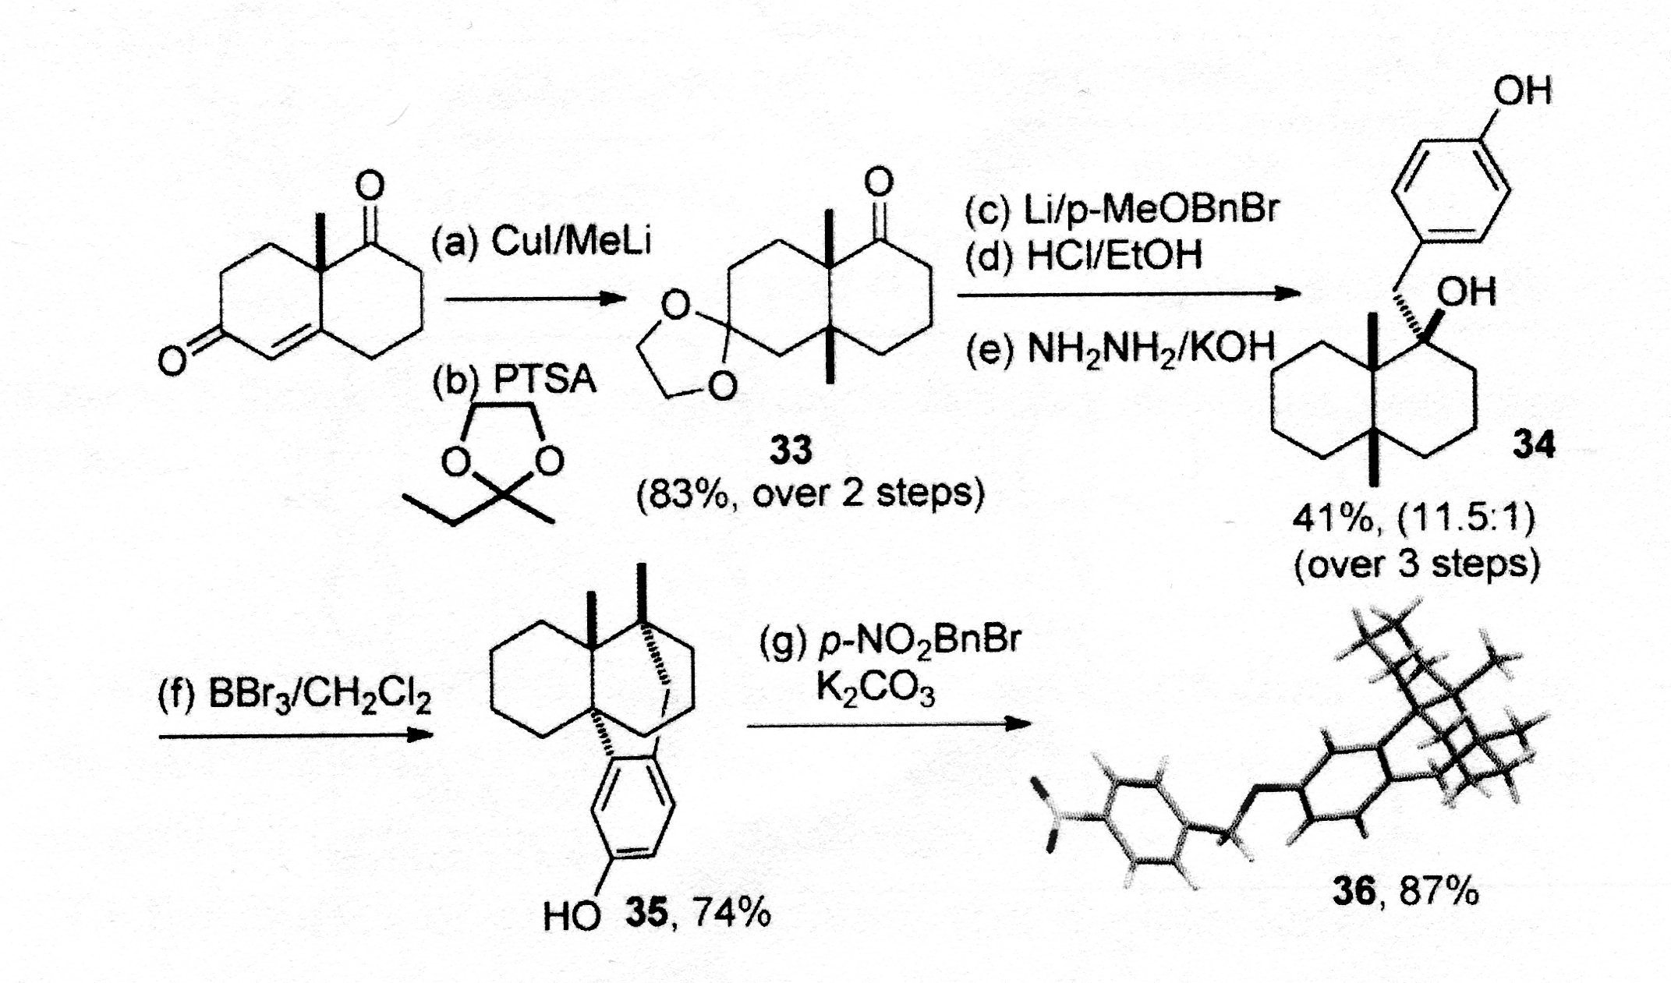
“… The relative orientation of three contiguous all-carbon quaternary
stereocenters was confirmed from the X-Ray Structure of the corresponding
p-nitrobenzyl ether 36. …”

Slide 9
What about the Xtal Details ?
There are no experimental details in the paper.
The paper gives no CSD reference codes in the printed text.
The journal site offers supplementary material in PDF format including a ‘Table 1’ with selected experimental details (including a CSD reference number.
The missing details (in CIF format) could be found in the CSD. An FCF could be reconstructed based on the embedded .res & .hkl.
Did the referee(s) have access to those data ?

Slide 10
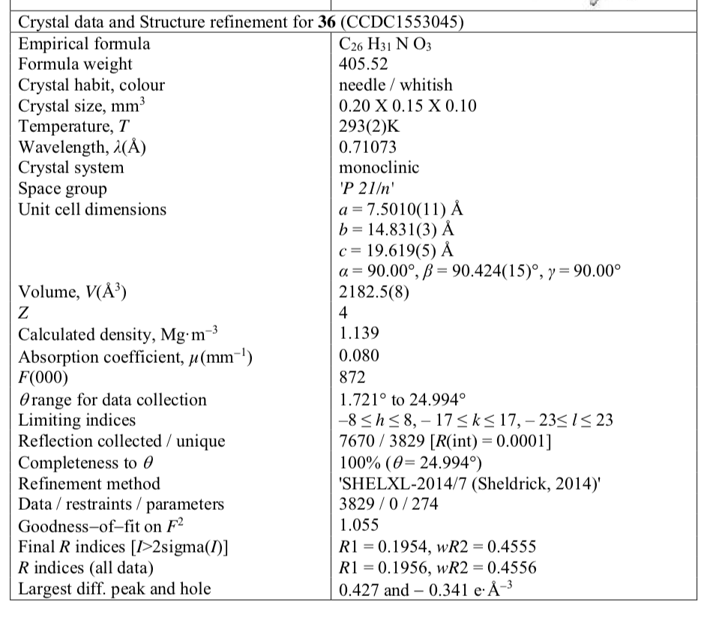
←
←
⬅

Slide 11
10% Probability Displacement Ellipsoid Plot
High ‘thermal’ motion
Looks reasonable notwithstanding the high R and wR2 values

Slide 12
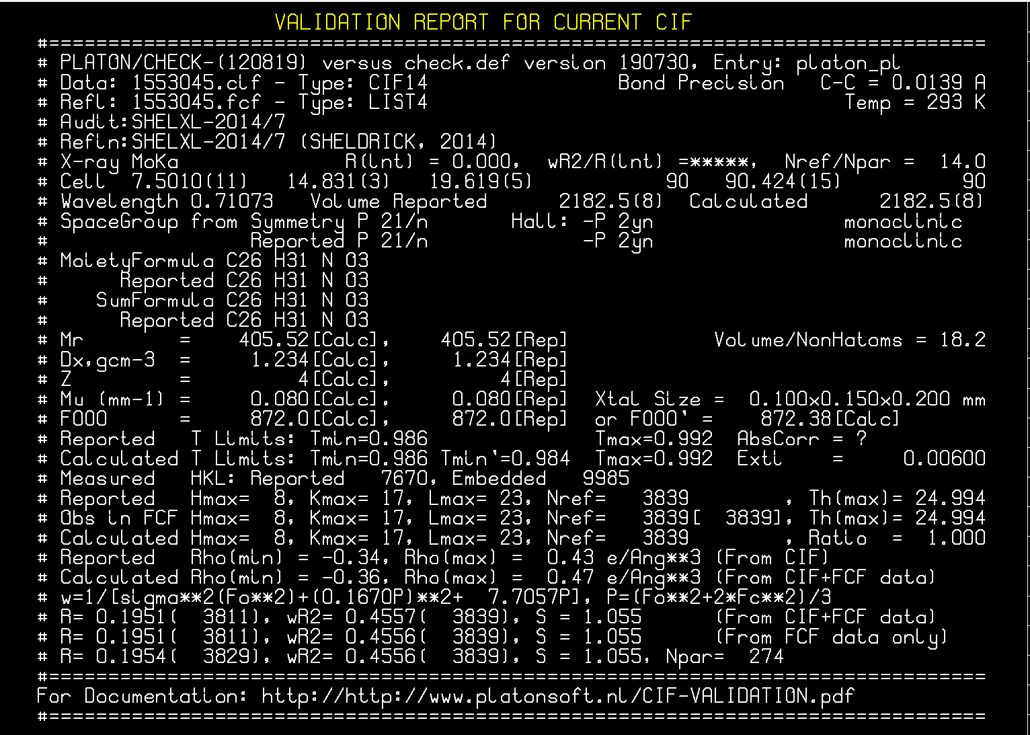

Slide 13
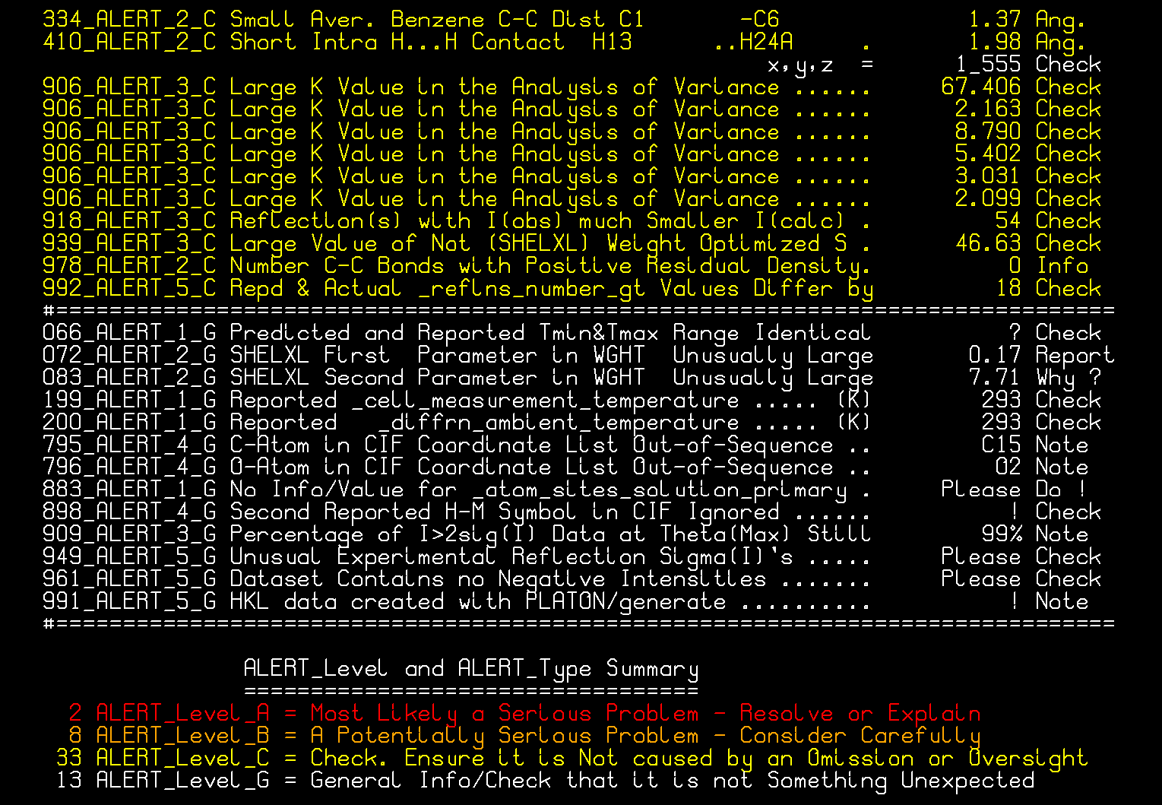

Slide 14
Inspection of the hkl data
Diederichs Plot: I_{obs}/sigma(I_{obs}) versus _{Iobs}
1 – expected
2 – for this structure
Also:
Plot sigma(I_{obs}) versus sqrt(I_{obs})

Slide 15
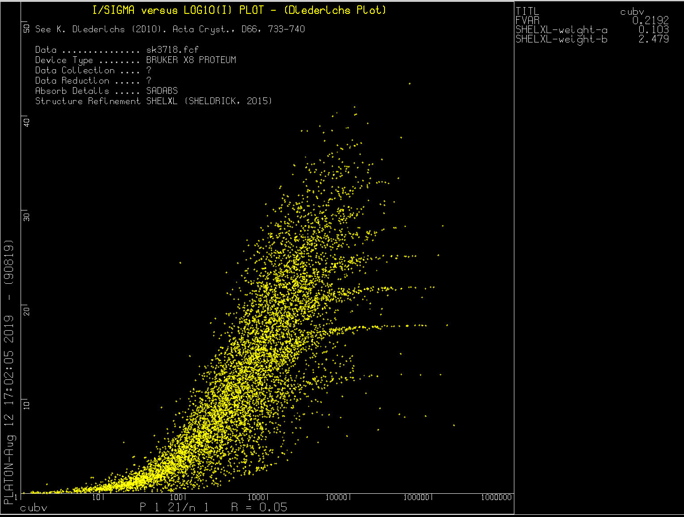
Example of a Normal Diederichs Plot

Slide 16
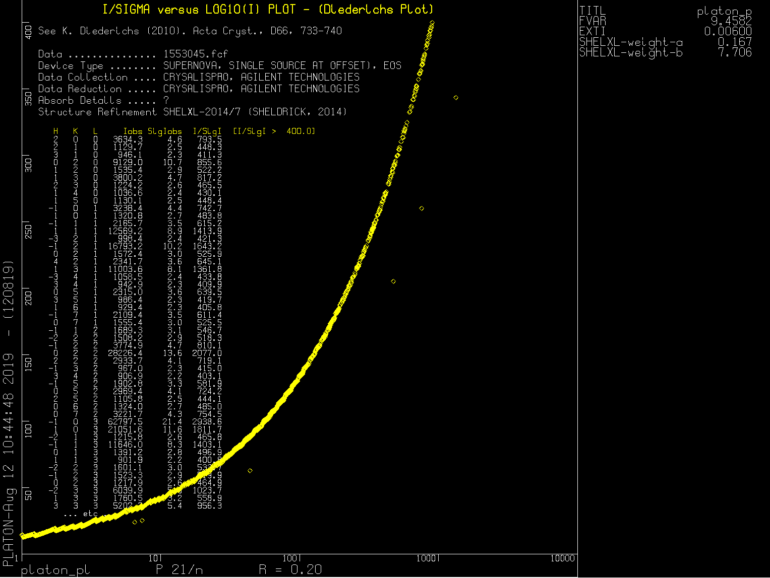

Slide 17
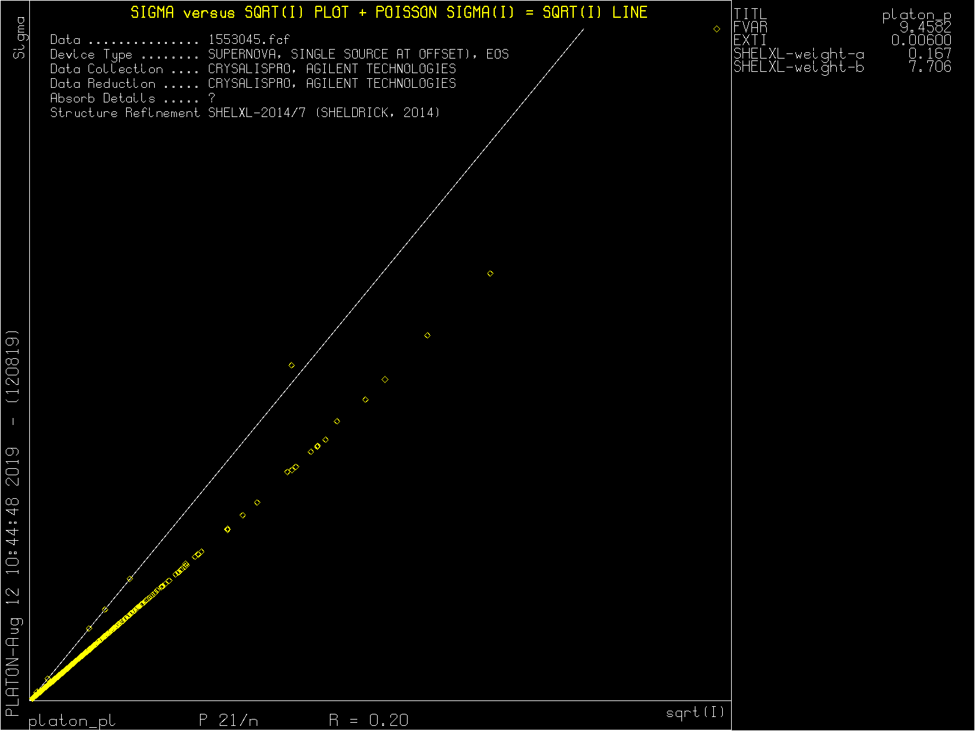

Slide 18
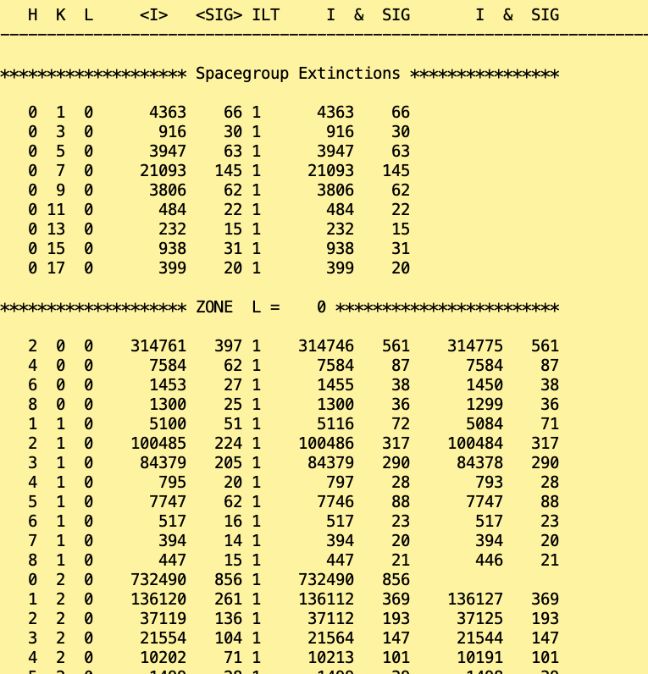
Top of ASYM output listing
Based on the
CIF embedded
unmerged set
of calculated
‘observed’ data

Slide 19
What might have happened ?
No details of the data processing are available, however there are traces in the CIF data that suggest that the structure was originally solved in Pn and subsequently, using PLATON/ADDSYM, transformed to P2₁/n.
Another PLATON tool, stricktly intended for testing purposes only, was apparently used to create ‘observed data’ for the final refinement, substituting the real observed data.

Slide 20
Thus …
The currently archived data in the CSD are largely useless for this structure.
This example might make a case for (automated) archival of the diffraction images along with the availability of evaluation tools.

Slide 21
Archival of Diffraction Images?
The solution of some problems with a structure may require the need to go back to the (archived) diffraction images.
Additional spots may indicate twinning, super cells, disorder [Integration erroneous]
Sometimes re-integration will be needed
Alternatively, qualitative info about the images might be sufficient to resolve questions.
It might be helpful to archive some synthetic precession images

Slide 22
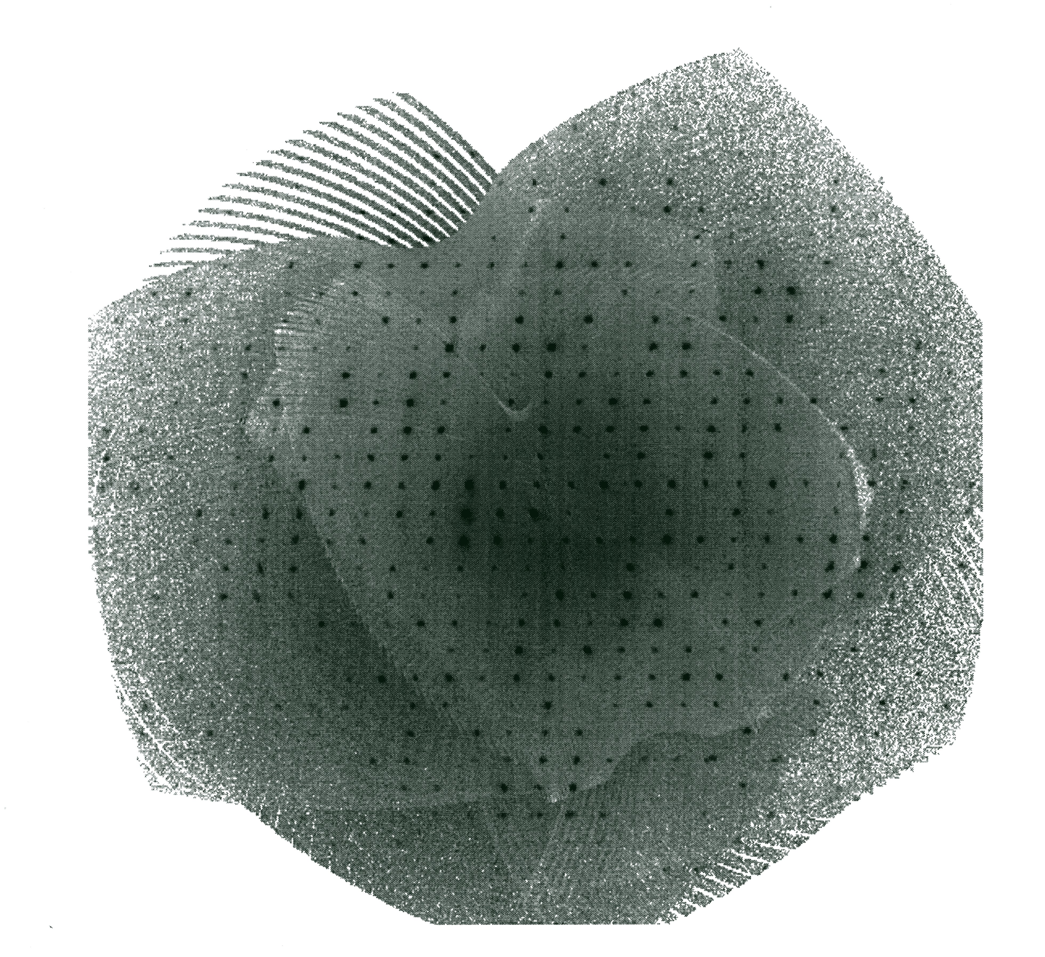
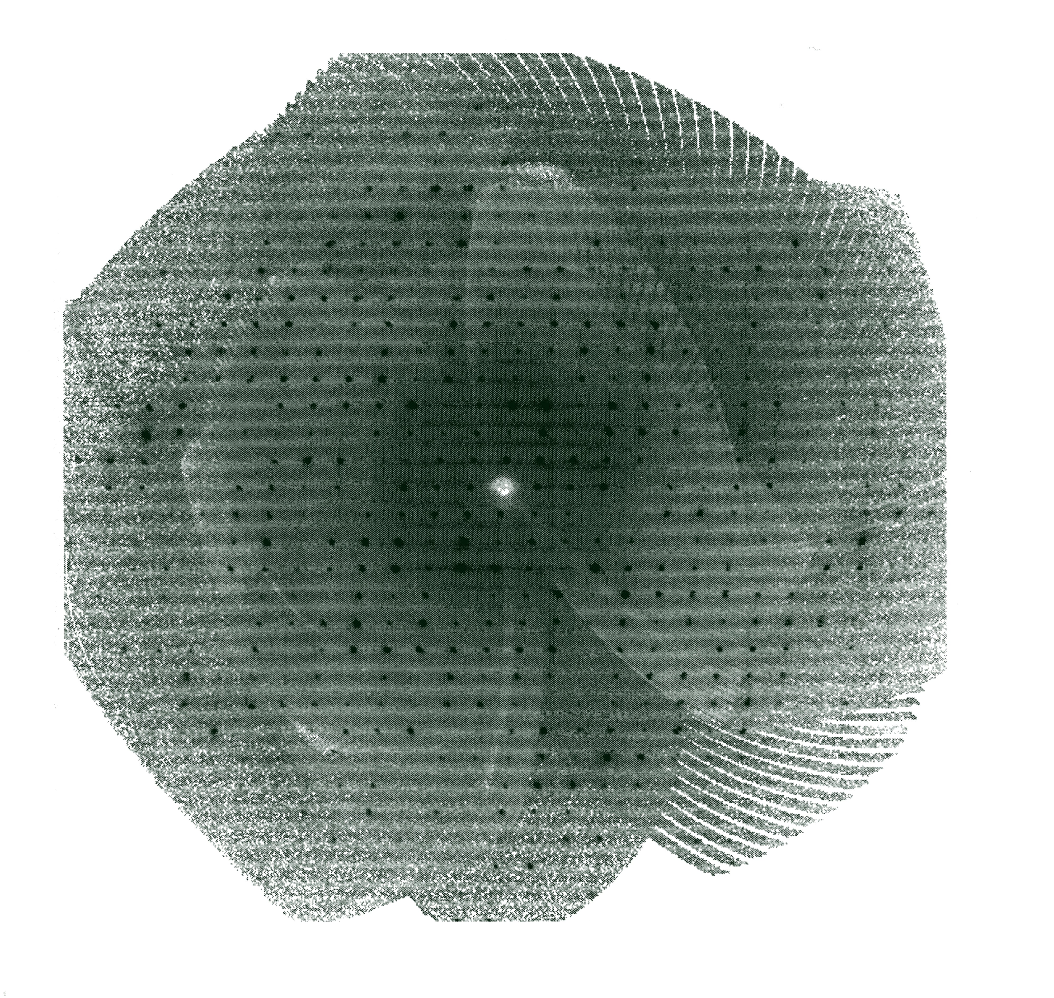
Synthetic Precession Images
0kl
1kl

Slide 23
Finally
An (automatically created) validation report of the image processing with details about streaks, additional (weak) diffraction spots, diffuse scattering etc. might be very helpful to understand structure analysis problems.

Slide 24
Thanks !
a.l.spek@uu.nl
http://www.cryst.chem.uu.nl/spek

